Slide 1
Weekly Update
Late To the Party Team
Brian Zhang, Saurav Chatterjee, Zachary Stephens
Faculty Advisor: John Leonard
Sponsor: Michael Karafotis
10/14/2019

Slide 2
Goals for this Week
Expand and solidify node map to incorporate two businesses with different structures (ie, one-to-one infrastructure/app relationships, versus shared platforms)
Focus on using D3 libraries for Force-based label placement graph
Use faker library in Python to randomly generate data
Fill out a lot of the requirements documentation with the new details gained from the previous meeting on Friday.

Slide 3
Accomplishments/Challenges Encountered
Accomplishments:
We learned a lot of new technologies and spec for the project
Set up new IDE for python development (Pycharm and Jupyter)
Challenges:
We have more details and specs for the project, which expands our scope. This increases the complexity of the project
Learning Python
Working with the new technologies presented such as D3 libraries and NeworkX and see which one works the best for the new specs.
Per our Friday meeting at BoA, we have been encouraged to consider alternative technologies for modeling and data generation.

Slide 4
Goals for Next Week
Explore the uses of the new technologies such as NetworkX and D3 libraries
Keep working on our Neo4j graph and increase the functionalities and relationships in it
Hopefully, plan another meeting later this week with our sponsor to talk the new changes with him
Work on setting up a server where we can all access and execute code using the same setup and tools, rather than three unique instances of various versions, tools, etc.

Slide 5
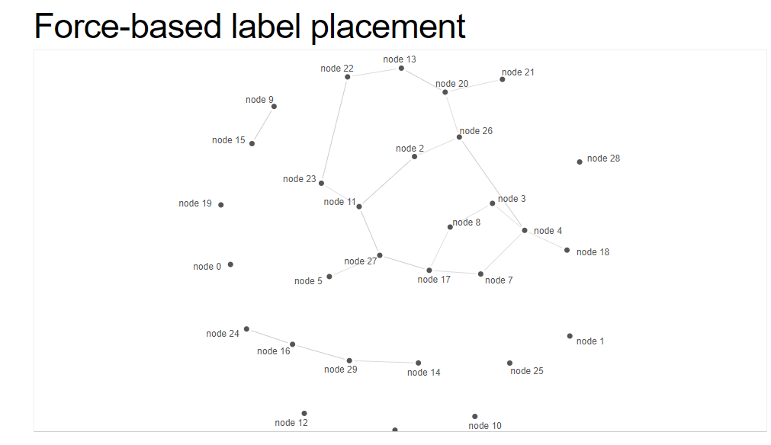
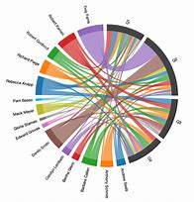
D3 library graph
Chord Diagram
Source: http://bl.ocks.org/MoritzStefaner/1377729 , https://www.bing.com/images/search?q=chord+diagram&form=HDRSC2&first=1&cw=1903&ch=937

Slide 6
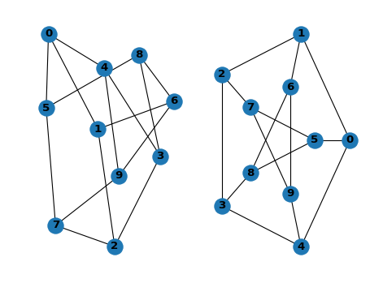
NetworkX
Source: https://networkx.github.io/documentation/stable/tutorial.html

